Slide 1
Respiratory distress in newborn
By Dr. Mohammed Abubeker
(M.D, asst. professor of pediatrics and child health)
1/10/2024

Slide 2
OUTLINES
PULMONARY HEMORRHAGE
PULMONARY AIR LEAKS
PERSISTENT PULMONARY HYPERTENSION OF THE NEWBORN
CONGENITAL DIAPHRAGMATIC HERNIA

Slide 3
PULMONARY HEMORRHAGE
Occurs in about 10% of extremely preterm infants.
Massive PH is less common and can be fatal.
Autopsy demonstrates massive PH in 15% of neonates who die in the 1st 2 wk of life.
The reported incidence at autopsy varies from 1-4 per 1,000 live births.
Approximately 75% of affected patients weigh <2,500 g at birth.
Prophylactic indomethacin in ELBW infants reduces the incidence of PH.

Slide 4
PULMONARY HEMORRHAGE….
Risk factor
PH is usually associated with a patent ductus arteriosus.
Rarer associations are preeclampsia, erythroblastosis fetalis, breech delivery, maternal cocaine use, coagulopathies, infection, asphyxia, hypothermia, congenital heart disease, and aspiration.

Slide 5
PH..PATHOGENESIS
Pulmonary hemorrhage is, in most cases, a hemorrhagic pulmonary edema due to high pulmonary capillary pressures, increased filtration of fluid into the lung, and disruptions in the endothelial–epithelial barrier that cause hemorrhagic fluid to enter the air spaces.
Underlying conditions may be acute left ventricular failure from hypoxia and severe acidosis or a patent ductus arteriosus.
Notes:
Bleeding into other organs is observed at autopsy of severely ill neonates, suggesting an additional bleeding diathesis, such as disseminated intravascular coagulation

Slide 6
PH..PATHOGENESIS…
Pulmonary hemorrhage is seen with all surfactants;
    Related to the rapid increase in pulmonary blood flow that occurs with the improvement in lung function after surfactant administration.
    the incidence ranges from 1–5% of treated infants and is higher with natural surfactant.
    Bleeding is predominantly alveolar in approximately 65% of cases and interstitial in the rest.
Sepsis may be a contributory factor in some cases.

Slide 7
CLINICAL FEATURES AND DIAGNOSIS
Increased respiratory distress, apnea, pallor, peripheral vasoconstriction, and bradycardia minutes before the onset of hemorrhage are common.
Severe metabolic acidosis may precede the onset of hemorrhage.
With massive hemorrhage, blood may flow out from the nose and mouth or from an endotracheal tube.
normal to low hematocrit.
Chest radiographs - bilateral alveolar infiltrates.

Slide 8
MANAGEMENT
Immediate support and resuscitative measures
Underlying conditions such as sepsis, asphyxia, coagulopathy, or a patent ductus arteriosus should be treated promptly.
a high positive end expiratory pressure (PEEP) to control the bleeding
Endotracheal administration of epinephrine to cause constriction of the pulmonary vessels
Activated recombinant factor VII
Exogenous surfactant therapy.
Transfusion with packed red blood cells may be necessary to maintain adequate perfusion and blood volume.
  However, caution should be used with excessive transfusion volumes, which can increase in left atrial pressure and pulmonary edema.
Notes:
Although surfactant treatment has been associated with the development of pulmonary hemorrhage, administration of exogenous surfactant after the bleeding has occurred can improve lung compliance, because the presence of intraalveolar blood and protein can inactivate surfactant.

Slide 9
OUTCOMES
Mortality rates following PH are high, and range from 30% to 60% in premature infants.
Approximately 60% of the survivors develop chronic lung disease.
Mortality in term infants is related to the underlying precipitating disease process

Slide 10
PULMONARY AIR LEAKS
Air leaks may present as extrapulmonary gas collections in the pleural space or other locations, and can cause significant morbidity and even mortality.
Prompt diagnosis and intervention are essential with significant air leaks.

Slide 11
PULMONARY AIR LEAKS…
INCIDENCE
Spontaneous pneumothorax occurs in approximately 1% of infants born vaginally at term and in approximately 2% of those born via S/C.
Small air leaks in asymptomatic infants may go undetected and resolve spontaneously.
More common in infants with lung disease
Significantly higher in infants who require respiratory interventions at birth.
The use of antenatal steroids, gentler ventilation strategies and surfactant therapy in the preterm infant have led to a decline in the incidence of air leaks in newborn infants.

Slide 12
Etiology and Pathophysiology
The most common cause of pneumothorax is overdistention resulting in alveolar rupture.
Alveolar overdistention can occur with;
  Positive pressure ventilation during neonatal resuscitation, or
  “ball-valve” phenomenon that results from aspiration (classically meconium)
  bronchial/bronchiolar obstruction.
Spontaneous rupture of an underlying pulmonary malformation (e.g., lobar emphysema, congenital lung cyst, pneumatocele) occurs
it is usually in an otherwise normal lung, and no etiology is identified.

Slide 13
Etiology and Pathophysiology…
pulmonary hypoplasia
Pneumothorax tends to occur during the 1st few hr after birth
  is caused by reduced alveolar surface area and poorly compliant lungs.
It is associated with disorders of ;
  decreased amniotic fluid volume (Potter syndrome, renal agenesis, renal dysplasia, chronic amniotic fluid leak)
  Decreased fetal breathing movement (oligohydramnios, neuromuscular disease)
  Pulmonary space-occupying lesions (diaphragmatic hernia, pleural effusion, chylothorax), and
  Thoracic abnormalities (thoracic dystrophies).

Slide 14
Etiology and Pathophysiology…
Air leaks often manifest with pulmonary interstitial emphysema.
Air that has leaked from the alveoli may track through the perivascular and peribronchial cuffs to the hilum of the lung and rupture into the mediastinum (to produce a pneumomediastinum) or into the pleural space (to produce a pneumothorax).
More rarely, air may track from the mediastinum to the pericardial space (producing a pneumopericardium) or to the peritoneal cavity (producing a pneumoperitoneum).

Slide 15
Etiology and Pathophysiology…
Tension pneumothorax occurs:
  if an accumulation of air within the pleural space is sufficient to elevate intrapleural pressure above atmospheric pressure.
  Unilateral - results in impaired ventilation not only in the ipsilateral lung but also in the contralateral lung.
  Compression of the vena cava and torsion of the great vessels may interfere with venous return.
Notes:
Unilateral tension pneumothorax results in impaired ventilation not only in the ipsilateral lung but also in the contralateral lung because of a shift in the mediastinum toward the contralateral side. Compression of the vena cava and torsion of the great vessels may interfere with venous return.

Slide 16
Clinical Manifestations
Asymptomatic pneumothorax
  are hyperresonance and diminished ipsilateral breath sounds with or without tachypnea.
Symptomatic pneumothorax
  is characterized by respiratory distress, which varies from merely high respiratory rate to severe dyspnea, tachypnea, and cyanosis.
  Irritability and restlessness or apnea may be the earliest signs.
  The onset is usually sudden but may be gradual
P/E:
  chest asymmetry with an increased anteroposterior diameter, hyperresonance, and diminished or absent breath sounds.
  Displacement of the cardiac apex and point of maximal impulse.
  Abdominal distention.
  symmetry of findings does not rule it out (bilateral in 10%).
  In tension pneumothorax, signs of shock are typical.
Notes:
The heart is displaced toward the contralateral side, resulting in displacement of the cardiac apex and point of maximal impulse.
The diaphragm is displaced downward, as is the liver with right-sided pneumothorax, and may result in abdominal distention. Because pneumothorax may be bilateral in approximately 10% of patients, symmetry of findings does not rule it out. In tension pneumothorax, signs of shock are typical.

Slide 17
Clinical Manifestations…
Pneumomediastinum:
Can occur in patients with pneumothorax and is usually asymptomatic.
The degree of respiratory distress depends on the amount of trapped gas;
  if great, bulging of the midthoracic area is observed, the neck veins are distended, and blood pressure is low.
    are a result of tamponade of the systemic and pulmonary veins.
subcutaneous emphysema in newborn infants is almost pathognomonic of pneumomediastinum.
Notes:
Although often asymptomatic, subcutaneous emphysema in newborn infants is almost pathognomonic of pneumomediastinum

Slide 18
Clinical Manifestations…
Pulmonary interstitial emphysema (PIE)
may precede the development of a pneumothorax or may occur independently
increasing respiratory distress as a result of decreased compliance, hypercapnia, and hypoxemia.
In severe cases, it precedes the development of BPD.
Prevented by avoidance of high inspiratory or mean airway pressures
Treatment
  bronchoscopy - if evidence of mucous plugging
  selective intubation and ventilation of the uninvolved bronchus, oxygen, general respiratory care, and HFV.
Notes:
Hypoxemia is caused by an increased PA -aO 2 and intrapulmonary shunting. Progressive enlargement of blebs of gas may result in cystic dilation and respiratory deterioration resembling pneumothorax.

Slide 19
Diagnosis
Pneumothorax
  Dx is established by chest radiography, with the edge of the collapsed lung standing out in relief against the pneumothorax.
Pneumomediastinum
  hyperlucency around the heart border and between the sternum and the heart border
Transillumination of the thorax
U/S for associated renal anomalies.
Pulmonary hypoplasia is suggested by:
  signs of uterine compression (extremity contractures)
  a small thorax on chest radiographs
  severe hypoxia with hypercapnia, and
  signs of the primary disease (hypotonia, diaphragmatic hernia, Potter syndrome)
Notes:
Pneumothorax and other air leaks should be suspected in newborn infants who show signs of respiratory distress, are restless or irritable, or have a sudden change in condition. Transillumination of the thorax is often helpful in the emergency diagnosis of pneumothorax; the affected side transmits excessive light.

Slide 20
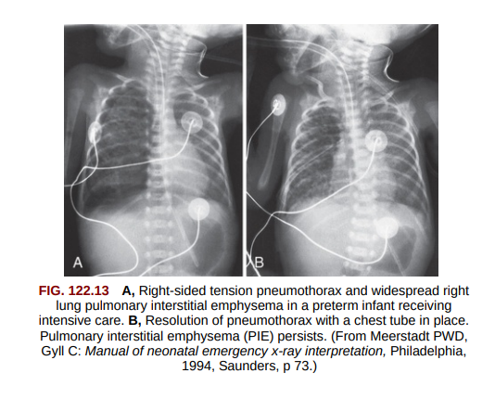
Diagnosis…

Slide 21
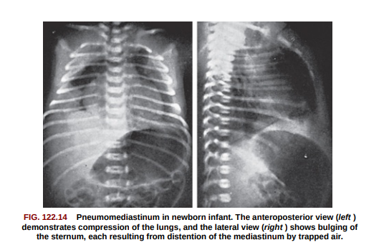
Diagnosis…

Slide 22
Diagnosis…
Pneumopericardium
may be asymptomatic, requiring only general supportive treatment, but it usually manifests as sudden shock with tachycardia, muffled heart sounds, and poor pulses suggesting tamponade.
Pneumoperitoneum
May be confused with intestinal perforation.
Abdominal paracentesis.
  Organisms on Gram stain suggests the intestinal perforation.
Can result in an abdominal compartment syndrome requiring decompression.
Notes:
Pneumoperitoneum from air dissecting through the diaphragmatic apertures during mechanical ventilation may be confused with intestinal perforation

Slide 23
Treatment
Close observation – if air leak is not continuous , asymptomatic and mildly symptomatic, small pneumothoraces
  Frequent small feedings and minimize crying
  Breathing 100% oxygen in term infants - resorption of free pleural air into blood by reducing the nitrogen tension in blood.
Emergency decompression by needle thoracentesis
a chest tube should be inserted and attached to underwater seal drainage.
If the air leak is ongoing, continuous suction (−5 to −20 cm H2 O)
A pneumopericardium - requires prompt evacuation of entrapped air.
Severe localized PIE - respond to selective bronchial intubation.
Surfactant therapy for RDS reduces the incidence of pneumothorax.
Notes:
Without a continued air leak, asymptomatic and mildly symptomatic, small pneumothoraces require only close observation.
Frequent small feedings may prevent gastric dilation and minimize crying, which can further compromise ventilation and worsen the pneumothorax.
Breathing 100% oxygen in term infants may accelerate the resorption of free pleural air into blood by reducing the nitrogen tension in blood.

Slide 24
Persistent Pulmonary Hypertension of the Newborn
I. DEFINITION. presents as severe unresponsive hypoxic respiratory failure.
  It reflects failure of the transition of fetal to neonatal circulation.
  PPHN is associated with a high mortality risk and risk of neurodevelopmental disabilities.
  PPHN also has been called “persistent fetal circulation.”

Slide 25
PPHN…
II. EPIDEMIOLOGIC ASSOCIATIONS.
PPHN occurs at a rate of 1 to 2 per 1,000 live births and is most common among full-term and post-term infants.
Risk factors for PPHN includs;
  Maternal diabetes mellitus
  Urinary tract infection during pregnancy
  Cesarean section delivery.
  Meconium-stained amniotic fluid
  Maternal fever, anemia, and pulmonary disease
  Male infants and those of black or Hispanic race are also at an increased risk for PPHN.

Slide 26
mechanisms of antenatal pathogenesis remain uncertain
Perinatal and neonatal conditions that have well-established links with PPHN.
A. Perinatal asphyxia is the most common associated comorbidity.
  Long-standing fetal stress and hypoxemia- remodeling and abnormal muscularization of pulmonary arterioles.
  Acute birth asphyxia - causes release of vasoconstricting humoral factors and suppression of pulmonary vasodilators
B. Pulmonary parenchymal diseases, RSD, pneumonia, and MAS also are associated with an increased risk of PPHN.
  In most such cases, the PHN is easily reversible, suggesting a transient vasospasm.
  The risk of PHN is greater when the fetus is of more advanced gestational age.
Notes:
The risk of pulmonary hypertension appears to be greater when the fetus is of more advanced gestational age, suggesting that the stage of pulmonary vascular development might play a role in susceptibility to PPHN
Acute birth asphyxia - causes release of vasoconstricting humoral factors and suppression of pulmonary vasodilators, thus contributing to pulmonary vasospasm

Slide 27
C. Abnormalities of pulmonary development contribute structurally to PPHN, either by
Pruning of the vascular tree
  congenital diaphragmatic hernia, Potter’s syndrome, and other forms of pulmonary parenchymal hypoplasia, or
Malalignment of pulmonary veins and arteries
  alveolar capillary dysplasia.
D. Pneumonia and/or sepsis of bacterial or viral origin can initiate PPHN.
  pathophysiologic mechanisms
    suppression of endogenous nitric oxide (NO) production
    endotoxin-mediated myocardial depression, and
    pulmonary vasoconstriction associated with release of thromboxanes.
Notes:
Pneumonia and/or sepsis of bacterial or viral origin can initiate PPHN.
Underlying pathophysiologic mechanisms that contribute to pulmonary hypertension in this clinical setting include suppression of endogenous nitric oxide (NO) production, endotoxin-mediated myocardial depression, and pulmonary vasoconstriction associated with release of thromboxanes

Slide 28
E. Myocardial dysfunction, myocarditis, intrauterine constriction of the ductus arteriosus, and several forms of congenital heart disease, including left- and right sided obstructive lesions, can lead to pulmonary arterial/venous hypertension.
F. Although familial recurrence of PPHN is uncommon, genetic predisposition might play a role in PPHN risk.

Slide 29
III. PATHOLOGY AND PATHOPHYSIOLOGY
A. Pulmonary vascular remodeling
  is pathognomonic of idiopathic PPHN and fatal PPHN.
  Abnormal muscularization of the normally nonmuscular intra-acinar arteries, with increased medial thickness of the larger muscular arteries-
    results in a decreased cross-sectional area of the pulmonary vascular bed and elevated PVR.
  One possible stimulus to pulmonary vascular remodeling is fetal hypoxemia.
.B. Pulmonary hypoplasia - affects both alveolar and pulmonary arteriolar development.
It may be an isolated anomaly or be a part of congenital diaphragmatic hernia, oligohydramnios syndrome, or renal agenesis (i.e., Potter’s syndrome)
Notes:
Laboratory and limited clinical data suggest that vascular changes might also occur following fetal exposure to nonsteroidal anti-inflammatory agents that cause constriction of the fetal ductus arteriosus and associated fetal pulmonary overcirculation
One possible stimulus to pulmonary vascular remodeling is fetal hypoxemia.
Humoral growth factors released by hypoxia-damaged endothelial cells promote vasoconstriction and overgrowth of the pulmonary vascular muscular media.

Slide 30
C. Reversible pulmonary vasospasm, nonfatal PPHN
  Is of ten due to lung disease, infections, or acute asphyxia.
  Hypoxia induces profound pulmonaryVC, and this response is exaggerated by acidemia.
  Suppression of endogenous NO, prostacyclin, or bradykinin production and release of thromboxanes (A2 and its metabolite, B2), and leukotrienes (C4 and D4)
    appear to mediate the increased PVR seen with sepsis and hypoxemia.
Notes:
Neural and humoral vasoactive substances each might contribute to the pathogenesis of PPHN.
These include factors associated with platelet activation and production of arachidonic acid metabolites.

Slide 31
D. Myocardial dysfunction with elevated PVR.
Congenital diaphragmatic hernia is often associated with intractable PPHN.
A combination of RV hypertrophy and/or failure and LV hypoplasia (because of reduced pulmonary venous return during fetal life) with pulmonary venous hypertension results in severe PPHN.
  will not respond to conventional pulmonary vasodilator therapy, until ventricular function improves.
Notes:
A combination of RV hypertrophy and/or failure and LV hypoplasia (because of reduced pulmonary venous return during fetal life) with pulmonary venous hypertension results in severe PPHN.
will not respond to conventional pulmonary vasodilator therapy, until ventricular function improves.

Slide 32
1. RV dysfunction can be caused by intrauterine constriction of the ductus arteriosus, which results in higher PVR, RV failure, and an atrial right-to-left shunt.
  Furthermore, RV failure resulting in altered diastolic compliance causes right-tol eft atrial shunting, even in the absence of elevated PVR.
2. LV dysfunction causes pulmonary venous hypertension and secondary pulmonary arterial hypertension (PAH), contributing to right-to-left hemodynamic shunting through the ductus arteriosus.
  Treating this form of pulmonary hypertension requires an approach that improves LV function rather than simply lowering PVR.

Slide 33
E. Mechanical factors that influence PVR include cardiac output and blood viscosity.
  Hyperviscosity( polycythemia), reduces pulmonary microvasculature perfusion.

Slide 34
IV. DIAGNOSIS. PPHN should always be considered in evaluating a cyanotic newborn
A. DDX OF PPHN - CCHD, sepsis, and severe pulmonary parenchymal disease.
B. The infant with PPHN appears very sick and has unresponsive cyanosis
C. A gradient of 10% or more in oxygenation saturation between simultaneous preductal (right upper extremity) and postductal (lower extremity) arterial blood gas (ABG) values
Because a subset of infants with PPHN has closure of the ductus arteriosus and their hemodynamic shunting occurs only at the foramen ovale, the absence of differential cyanosis or SaO2 does not exclude PPHN.
Notes:
. In some infants, the cyanosis might be appreciably different between regions perfused by preductal and postductal vasculature (differential cyanosis). The cardiac examination may be normal, or there may be a prominent precordial impulse, a single or narrowly split and accentuated second heart sound, and sometimes, a systolic murmur consistent with tricuspid regurgitation (TR). A significant murmur misleads the neonatologist and CCHD looks the likely diagnosis.

Slide 35
D. The chest radiograph usually appears normal or shows associated pulmonary parenchymal disease.
  The cardiothymic silhouette is normal, and pulmonary blood flow is normal or diminished.
E. The electrocardiogram (ECG)
Most commonly shows RV predominance that is within the range considered normal for age.
Less commonly, an axis that is left (or “normal”) suggests poor RV function and poor prognosis.
An abnormal axis may also point to CCHD.

Slide 36
V. MANAGEMENT.
PPHN is a medical emergency in which immediate, appropriate intervention is critical to reverse hypoxemia, improve pulmonary and systemic perfusion, and preserve end-organ function.
Adequate respiratory support to optimize oxygenation, ventilation (carbon dioxide), and acid–base status (pH) facilitates the fall in PVR.

Slide 37
CONGENITAL DIAPHRAGMATIC HERNIA
Epidemiology
The incidence of CDH is between 1 in 2,000 and 1 in 5,000 live births.
Females affected twice as often as males.
More common on the left (85%) and are occasionally bilateral (<5%).
Pulmonary hypoplasia and malrotation of the intestine are part of the lesion, not associated anomalies.

Slide 38
CDH…
Most cases of CDH are sporadic, but familial cases have been reported.
Associated anomalies have been reported in up to 30% of cases, including CNS lesions, esophageal atresia, omphalocele, and cardiovascular lesions.
CDH is recognized as part of several chromosomal syndromes: trisomies 21, 13, and 18 and Fryns, Brachmann–de Lange, Pallister-Killian, and Turner syndromes.

Slide 39
CDH…
TYPES OF DIAPHRAGMATIC HERNIA
a Bochdalek hernia (most common type of CDH), occurs through a posterior defect in the diaphragm.
a Morgagni hernia, anterior retrosternal hernia, the central and lateral portions of the diaphragm
the stomach, spleen, and most of the intestines herniate into the thorax.
In rare instances, the liver and kidneys may also be in the thoracic cavity.
Herniation of the abdominal content- results in pulmonary hypoplasia that is most severe on the ipsilateral side.
Pulmonary capillary blood flow is decreased.
Surfactant production may also be affected by pulmonary hypoplasia in infants with CDH.
Notes:
Herniation of the abdominal contents interferes with lung development and growth, and the resulting lung compression results in pulmonary hypoplasia that is most severe on the ipsilateral side, although both lungs may be affected. There is a marked reduction in the number of bronchi and alveoli associated with a decrease in cross-sectional area of the pulmonary vasculature. In addition to parenchymal maldevelopment, the intra-acinar pulmonary arteries have increased muscularization. Pulmonary capillary blood flow is decreased because of the small cross-sectional area of the pulmonary vascular bed, and flow may be further decreased by abnormal pulmonary vasoconstriction.

Slide 40
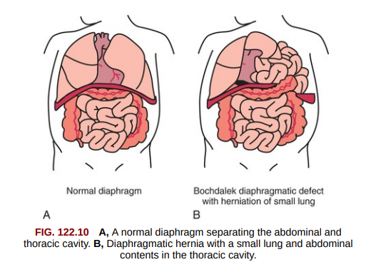
CDH…

Slide 41
CDH…
PRENATAL DIAGNOSIS
In >50% of cases, CDH can be diagnosed on prenatal US between 16 and 24 wk of gestation.
High-speed fetal MRI can further define the lesion.
Fetal ultrasound:-
  reveal abdominal organs and fluid-filled bowel with peristalsis in the thorax, and
  a shift of the heart and mediastinum away from the side of the hernia.
Polyhydramnios, pleural effusions, and ascites often are present.
Fetal Echo. and karyotype – for diagnosis of common associated malformations.
Notes:
Fetal surgical procedures for CDH have failed to improve survival or decrease morbidity and are not routinely recommended at present
Minimally invasive fetal endoscopic tracheal occlusion (FETO) has been studied in fetuses diagnosed with CDH and a large randomized controlled trial is underway.

Slide 42
CDH…
CLINICAL FEATURES
Depends on the type and size of the hernia.
  large left-sided hernia
    may present with a scaphoid abdomen and significant respiratory symptoms in the delivery room.
    Breath sounds may not be heard on either side of the chest
    bowel sounds may be audible in the chest, and
    the heart sounds may be better heard on the right side.
  The infant’s respiratory status may worsen as air is swallowed and fills the bowel in the chest, compressing the lungs.
  Chest and abdominal radiographs should be done after an orogastric tube is placed.
Notes:
Chest and abdominal radiographs should be done after an orogastric tube is placed.
These will reveal the abdominal organs and feeding tube in the thoracic cavity and displacement of the heart and mediastinum to the contralateral side.

Slide 43
  Right-sided hernia
  may be asymptomatic at birth, and the diagnosis may be incidental if not made prenatally.
  the liver and some intestine may occupy the right hemithorax, but little or no displacement of the heart may occur.
  have a better prognosis because they generally have less lung hypoplasia.
Notes:
Echocardiography, chromosomal analysis, and renal U/S secondary to the high incidence of associated malformations.

Slide 44
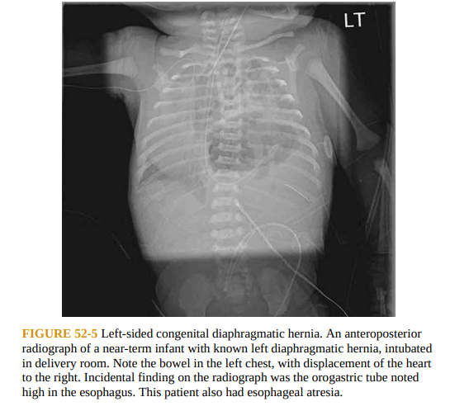

Slide 45
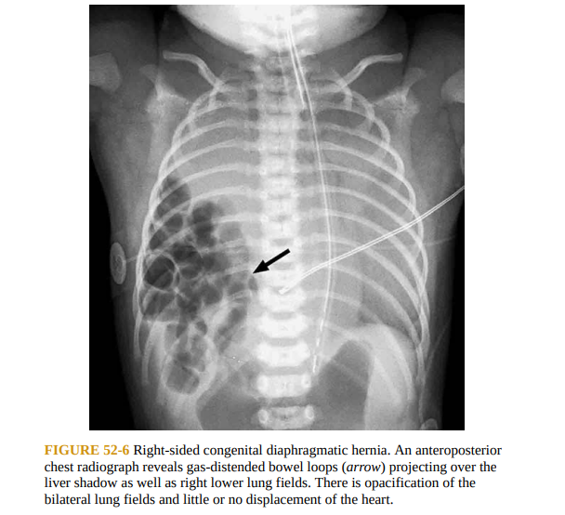

Slide 46
Approximately 40% of infants with CDH have associated anomalies
During fetal life, the left ventricle is often small (probably as a result of increased intrathoracic pressure) and left ventricular output is reduced.
Postnatally, the left ventricular size and output may improve with correction of the hernia.
Notes:
Approximately 40% of infants with CDH have associated anomalies, most with minimal effect on survival, and others that significantly affect survival, including chromosomal and complex cardiac defects.

Slide 47
MANAGEMENT
  a double-lumen orogastric tube should be placed into the infant’s stomach in the delivery room to reduce air in the bowel and decrease compression of the lung.
  If assisted ventilation ( via an endotracheal tube)
  Bag and mask ventilation should be avoided.
  Close monitoring of oxygenation and radiological evaluation
  umbilical catheters should be placed for medications and for blood gas monitoring.
  Sedation may be needed to avoid the need for higher pressures and occurrence of pneumothorax.
POSTNATAL CARE
  Directed toward lung function and pulmonary hypertension.
  Surgical intervention is delayed where possible, until the infant is hemodynamically stable and pulmonary hypertension is controlled.
  Mechanical ventilation is currently based on principles of “gentle ventilation.”
Notes:
If assisted ventilation is required, it should be performed via an endotracheal tube, using the lowest peak pressure (≤ 25 cm H2O) possible to prevent air leaks and lung injury. Sedation may be needed to avoid the need for higher pressures and occurrence of pneumothorax

Slide 48
MEDICAL INTERVENTIONS
Surfactant
  Surfactant therapy in CDH has no reported benefits, and may cause clinical deterioration and increased mortality.
Ventilation Strategy
  a gentler ventilation strategy, which allows for higher PaCO2 and lower preductal oxygen saturation as long as blood pressure and tissue perfusion are maintained.
Notes:
Pulmonary hypoplasia and pulmonary hypertension are significant contributors to mortality in CDH.

Slide 49
Nitric Oxide
  it has not had the same success for infants with CDH like PPHN.
Extracorporeal Membrane Oxygenation ECMO
  is now used more frequently during preoperative stabilization.
Notes:
Although iNO is an effective treatment for infants with PPHN in general, it has not had the same success for infants with CDH, and may actually increase the death rate. Nonetheless, it is still widely used in the management of CDH. ECMOis often used as rescue therapy for CDH, although its efficacy is uncertain and its use is declining. The criteria for initiation of ECMO vary widely across centers. With the onset of delayed surgical repair, ECMO is now used more frequently during preoperative stabilization.

Slide 50
SURGICAL REPAIR
  Surgical repair of the diaphragmatic defect should be performed during the neonatal period.
  Fetal surgical procedures for CDH have failed to improve survival
  Currently, the preferred management strategy for CDH is medical stabilization with appropriate cardiorespiratory support.
Notes:
In the past, surgical intervention was considered emergent, and as a consequence, postoperative management was characterized by severe pulmonary hypertension and tension pneumothoraces, resulting in poor outcomes.

Slide 51
OUTCOMES
Position of the liver and the lung area–to–head circumference ratio (LHR) via ultrasound is important.
  There were no survivors with LHR <1, but all babies with LHR >1.4 survived.
  liver in the thoracic cavity is a poor prognostic feature.
Overall survival of live born infants with CDH is 71%.
Relative predictors of a poor prognosis include:
  an associated major anomaly
  symptoms before 24 hr of age
  severe pulmonary hypoplasia
  herniation to the contralateral lung, and
  the need for ECMO.
The size of the defect appears to be the strongest predictor of morbidity.

Slide 52
Survivors are at risk for chronic lung disease, feeding difficulties, gastroesophageal reflux, scoliosis, pectus excavatum, hearing loss, neurodevelopmental delay, brain injury, and recurrence of the diaphragmatic hernia.
Overall survival of patients with CDH and significant cardiac defects is lower than those without heart abnormalities.

Slide 53
THANK YOU

